Slide 1
Getting Started!
3G Release 99
(deployed today)

Slide 2
3GPP Release 99
(also known as Release 3”)
3GPP Release 99
Versions of
3GPP Release 1999
1999
2000
2001
2002
2003

Slide 3






3G Release 99 Circuit switched
UTRAN
SCP
3G MSC
AAL2
TDM
NodeB
RNC
Typically ATM
n x E1/T1 (IMA)
or STM-1
PSTN
USIM
HLR
AUC
New phones required
AMR codec variable to 12Kbps
Node B (3G base station)
W-CDMA 2GHz
AAL2/ATM transport
QoS
Radio Node Controller (RNC)
AAL2/ATM transport
Handover
QoS
Forwards to CS and PS core
UMTS Subscriber Identity Module
New SIM
UMTS Terrestrial Radio Access Network (UTRAN)

Slide 4



3G Release 99 Packet switched
SCP
RNC
3G MSC
AAL2
TDM
NodeB
PSTN
USIM
IP/AAL5
HLR
AUC
IP
Internet
Corporate
3G SGSN
Packet transfer to & from serving area
Registration, authentication
Mobility management
logical links to RNC, tunnel to GGSN
QoS
3G GGSN
Multiple PDP contexts
QoS (GPRS extensions for real time traffic classes etc)

Slide 5
3G Release 99 Packet switched
SCP
RNC
Iu r
3G MSC
AAL2
Iu b
Iu cs
NodeB
PSTN
Iu ps
USIM
IP/AAL5
HLR
AUC
Gn
IP
Gi
Internet
Corporate

Slide 6
PDP context activation GPRS R99
MS
UTRAN
3G
-SGSN
3G
-GGSN
1. Activate PDP Context Request
C1
3.
Radio Access Bearer Setup
4. Invoke Trace
5. Create PDP Context Request
5. Create PDP Context Response
C2
7. Activate PDP Context Accept
Multiple PDP Contexts available Primary and Secondary
QoS across each bearer

Slide 7
Layer 2 – MPLS Migration

Slide 8
Optimizing the mobile transport network with MPLS
In Release 99, interfaces in the RAN and CN are based on an ATM link layer
  Iu b, Iu r, Iu cs, Iu ps
  GPRS PS interfaces based on FR link layer (Gb), Gn and Gi are IP interfaces
Can migrate ATM services onto an MPLS backbone using layer 2 techniques
Drivers
  Reduce need to build or expand ATM switch network; consolidate on IP
  Common infrastructure across layer 2 and 3 services; reduce capex and opex
  Future 3GPP releases migrate to native IP interfaces (eg- IP RAN)
  L2 MPLS can transport other non IP traffic in the mobile network (eg- ISO/CLNS)

Slide 9



GPRS example
SCP
BSC
& PCU
TDM
BTS
Gb FR
N x E1
PSTN
HLR
AUC
TDM
Transport
ISP /
Corporates
IP
IP
IPSEC
MPLS
GPRS Users

Slide 10

GPRS example
Using Layer 2 transport cont…
BSC
& PCU
BTS
Gb FR
N x E1
Access PE
Direct connect or via existing MPLS network
MPLS
Central PE
ISP /
Corporates
IP
IP
IPSEC
MPLS
GPRS Users

Slide 11
Layer 2 Transport in Release 99
MPLS network for core and also access
SCP
3G MSC
AAL2 ATM
Iu r
AAL2 ATM
Iu b
Iu cs
AAL2 ATM
NodeB
RNC
PSTN
USIM
Iu ps
AUC
IP/AAL5
ATM STM-1
HLR
Common MPLS
Network
Gn
IP
Gi
Internet
Corporate

Slide 12
Layer 2 Transport Over MPLS
Encapsulation of FR/ATM/Ethernet is per IETF drafts in Pseudo Wire Emulation Edge to Edge (pwe3) working group
  Used both for L2 VPNs and L2 Circuits
  draft-ietf-pwe3-ethernet-encap-05.txt – Ethernet
  draft-ietf-pwe3-atm-encap-04.txt – ATM cell/frames
  draft-ietf-pwe3-frame-relay-02.txt - FR
For example, for Frame Relay: at the ingress, the DLCI is removed, replaced by a two-label stack and a control word
At the egress, the label stack is popped, the control word consulted and removed, and a new DLCI is added
Label signalling either uses targeted LDP (martini approach) or mBGP (kompella approach) – independent from forwarding

Slide 13









MPLS Point-to-point Layer 2 VPNs
VPN A
Site2
VPN A
Site 1
CE–A2
CE–A1
VPN B
Site2
P
DLCI
200
DLCI
100
P
DLCI
111
PE 2
PE 1
CE–B2
VPN B
Site 1
DLCI
222
VPN A
Site 3
P
P
PE 3
CE–B1
CE–A3
Customer frames are switched based on DLCI/VCI/VLAN
  Each DLCI from a CE identifies a remote CE
The PE to PE virtual circuit is replaced by an MPLS LSP
  If a frame sent on DLCI 100 goes to CE x, then a frame received on DLCI 100 comes from CE x
Customer still thinks they are connected to a FR switch

Slide 14

Forwarding for MPLS Layer 2 VPNs
PE2
CE 2
789
LSPs
DLCI
200
CE 1
DLCI
100
PE1
DLCI
111
CE 3
654
DLCI
222
PE3
VFT at PE1 for CE1 PE1
VFT at PE1 for PE1 CE1
dlci | outer | demux
100 | 789 | 2001
111 | 654 | 3001
demux | dlci
1002 | 100
1003 | 111
Independent of how demux (inner/VC) label is signaled!

Slide 15


General Encapsulation
MPLS
Control
Word
IP Packet
L2
IP
L2
IP
CE
PE
PE
CE
PSN
Ingress PE:
  Strips L2 header
  Adds control word (if needed) and MPLS labels
Egress PE:
  Reconstructs L2 header

Slide 16
Control Word
4 4 2 6 16
Rsvd
Flags
00
Length
Sequence Number
4 byte Control Word
CW is optional for:
  Ethernet
  ATM Cell Mode
  PPP/HDLC
CW is required, but its use is optional for:
  ATM AAL5 Mode
  Frame Relay
Rsvd – Reserved for future use
  Must be set to 0s
Flags – Varies by protocol
  Used in ATM AAL5 and Frame Relay
00 – must be set to 0
Length
  If payload + CW < 64 B, it must be set to packet’s length
  Otherwise, length field is set to 0
Sequence number is optional
  Set to 0 if not used

Slide 17
L2 VPN
ATM Cell Mode
ATM Control
Word
VPI
VCI
PTI
C
ATM Payload
(48 Octets)
VPI
VCI
PTI
C
ATM Payload
(48 Octets)
ATM Control
Word
VPI
VCI
PTI
C
ATM Payload
(48 Octets)
VPI
VCI
PTI
C
ATM Payload
(48 Octets)
CE
PE
PE
CE
PSN
Cells are transported without a SAR process
  Per VC, VP, or port mode
One or more cells are concatenated
  Maximum number of cells is limited by network MTU
VPI and VCI may be changed at egress

Slide 18
L2 VPN
ATM AAL5 Mode
RES
T
E
L
C
00
Length
Sequence
Number
ATM OAM Cell or
AAL 5 CPCS-SDU
CE
PE
PE
CE
PSN
VCC
VCC
ATM AAL5 Mode
  Flag bits are used to indicate:
    T: Packet contains an ATM Cell (OAM) or AAL5
    E: EFCI for Explicit Forward Congestion Indication
    L: CLP for cell loss priority
    C: C/R for FRF 8.1 FR/ATM service interworking

Slide 19
L2 VPN
Frame Relay
RES
B
F
D
C
00
Length
Sequence
Number
Frame Relay
PDU
CE
PE
PE
CE
PSN
VCC
VCC
Frame Relay flag bits:
  B: BECN
  F: FECN
  D: Discard Eligible
  C: C/R

Slide 20



L2VPN Case Study
Orange UK (France Telecom)
Enabling Multimedia Services
13m+ subscribers
IP/MPLS Backbone
CAPEX & opex savings
Interoperate with mixed RAN
Many network services
  IP Routing using the ISIS IGP and BGP;
  MPLS using RSVP and/or LDP for LSP signalling;
  Traffic Engineering
  MPLS Layer 3 2547bis VPNs;
  MPLS Layer 2 VPNs;
  QoS/CoS;
  Rate limiting and traffic shaping
  Planned - IPv6 (including v6 VPNs)
Internal Networks
3G
Internet
Gigabit Routed Network
Signaling
UTRAN
Corporate
Intranets
Copyright © 2003 Juniper Networks, Inc. Proprietary and Confidential www.juniper.net

Slide 21


Orange UK –
ATM over MPLS
Both AAL5 frame and ATM cell transport
VP or VC level
L2 techniques used
  Previously Circuit Cross Connect (CCC) - proprietary
  Now using kompella - same MBGP used in IPv4 VPN service, IPv6 VPN service (operational advantages)
Trunking between ATM switches
ATM Switch
M40e
(PE)
M40e
(PE)
ATM Switch
Native Layer 2 Services
- existing
Native
MPLS/PoS
Backbone
(RSVP TE)
Direct interface to mobile equipment
Copyright © 2003 Juniper Networks, Inc. Proprietary and Confidential www.juniper.net

Slide 22
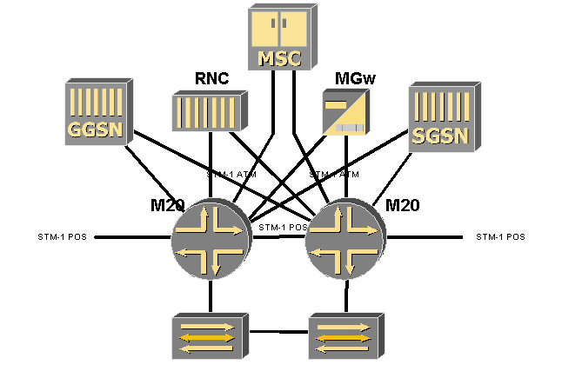

Case Study - European 3G operator –
Primary site design

Slide 23
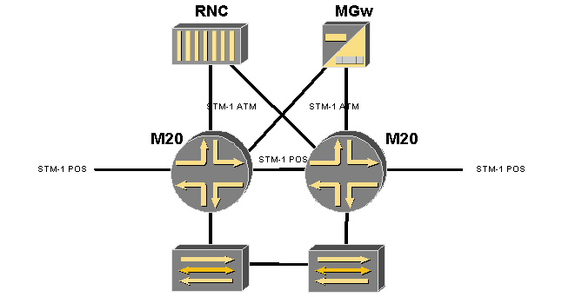
Case Study - European 3G operator –
Secondary site design
RNC

Slide 24
Case Study - European 3G operator –
Traffic carried on MPLS
  A multiservice network. Frame Relay, ATM and native IP.
  Iu-PS Control Plane (RANAP/ATM)
  Iu-PS User Plane (GTP/IP/ATM)
  Iu-CS Control Plane (RANAP/ATM)
  Iu-CS User Plane (AMR/ATM)
  Gn (GTP/IP/ATM)
  Gi (IP/ATM)
  Gr (MAP/ATM)
  Iur User Plane (AAL2/ATM)
  Iur Control Plane (RNSAP/ATM and Q.2630.1/ATM)
  Gb (BSSGP/FR)
  Use of RSVP LSPs with Fast Reroute and Secondary LSPs for sub second restoration (not relying solely on IGP eg using just LDP)

Slide 25

MPLS failure recovery
Fast reroute allows rapid switching to alternate link segments while longer-term repairs are made
Secondary LSPs provide deterministic alternate paths during link failure
Possible in a consistent, network-wide manner

Slide 26

MPLS Fast Reroute
Single user command
at head end to enable Fast Reroute.
Detour
Detour
Detour
Primary
Primary
Primary
Primary
LSR1
LSR2
LSR3
LSR4
LSR5
Fast reroute is signaled to each LSR in the path
Each LSR computes and sets up a detour path that avoids the next link and next LSR
Each LSR along the path uses the same route constraints used by head-end LSR

Slide 27
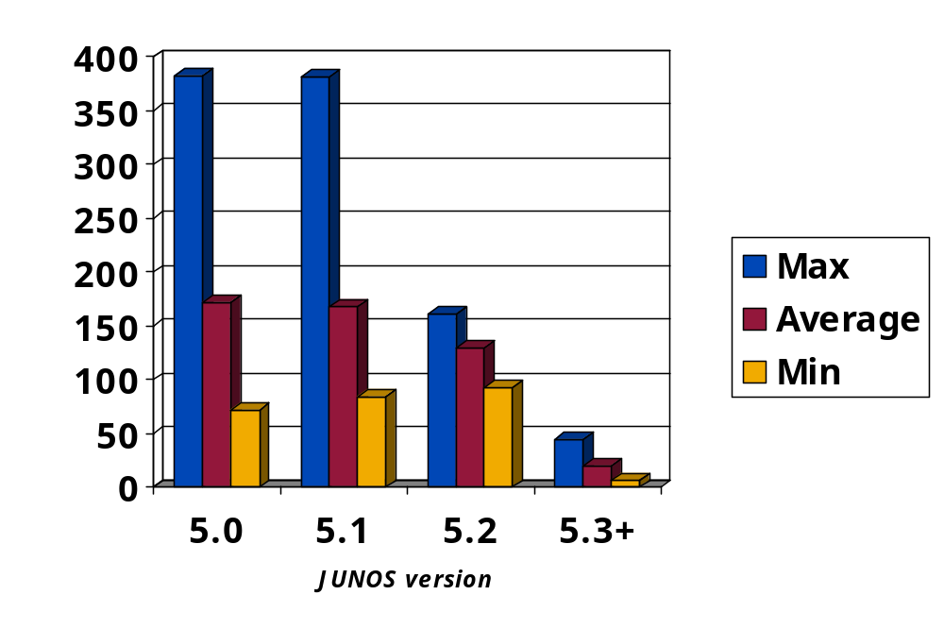
MPLS Fast Reroute:Recovery Times
msecs

Slide 28
Now for
3G Release 4
(deployments this year)
Eg- NTT DoCoMo has confirmed plans to release the latest version of 3G handsets during the first half of 2004 and to upgrade its FOMA network to 3GPP Release 4 specifications.

Slide 29

3G Release 4
TS 23.205 Split
TS 29.414 Bearer
BICC
Circuit switched
call control server
(MSC Server)
Mc
H.248 MEGACO
Nb
TDM
ATM
IP
NodeB
Media Gateway
(CS-MGW)
Media Gateway
PSTN
USIM
IP/AAL5
Split MSC into bearer and control
Bearer independent CS
New MGCP, new CS call control
Internet
Corporate
Streaming MMS service using PS streaming service 26.233

Slide 30
Release 4 – Nb interface options
Either ATM or IP transport is specified
AAL2 connection signalling (Q.2630.2)
AAL2 Signalling Transport Converter for MTP3b (Q.2150.1)
MTP3b
SSCF-NNI
SSCOP
AAL5
ATM
Tunnelling, as described in 3GPP TS 23.205, shall be used to transport the IP bearer control protocol IPBCP conform the ITU-T recommendation Q.1970 “BICC IP Bearer Control Protocol” (IPBCP) (see 3GPP TS 29.205).
AAL-2 SAR SSCS (I.366.1)
AAL2 (I.363.2)
ATM
RTP
UDP
IPv4 or IPv6
Protocol stack used for the transport network user plane
Protocol stack for the transport network control plane
IP Protocol stack for the transport network user plane

Slide 31
Next Steps…
3G Release 5

Slide 32

3G Release 5
23.228 IMS
25.933 IP UTRAN
BICC
Circuit switched
call control server
SIP
STACK
RTP
or
AAL2
H.248
UDP/IP or AAL2
TDM
ATM
IP
Iu b
Iu cs
NodeB
Iu ps
PSTN
USIM
IP/AAL5
Native IP UTRAN option
Call Session Control Function
IP multimedia control sub system (IMS) – IPv6, SIP based
Internet
Corporate
SIP IP Multimedia
CSCF
QoS enhancements (end-to-end)

Slide 33
IP RAN and Transition Techniques

Slide 34
IP UTRAN concept
Allows the use of IP-based transport technologies for UTRAN interfaces – Iu-CS, Iub and Iur (also Iu Ps in the packet core)
Carries both Radio and Signaling bearers
Independent from end-end connection (IP or not)
Requirements:
  Support efficient utilization of low-speed links
  eg- IP/UDP/RTP header compression, PPPmux, HC etc
  Support co-existence of AAL2/ATM and IP based transport technologies (eg- interwork with Release 99 or Release 4)
  Meet the stringent UTRAN delay and synchronization requirements
  IPv6 is mandatory, IPv4 is optional, dual stack is recommended
  DiffServ for QoS, hop by hop or edge-edge

Slide 35
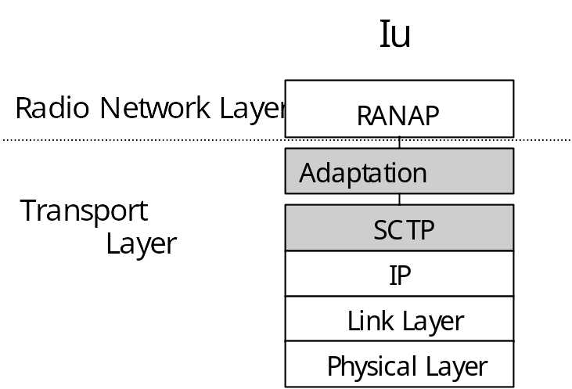
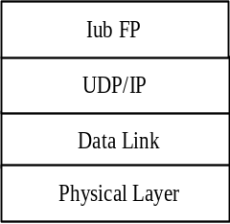
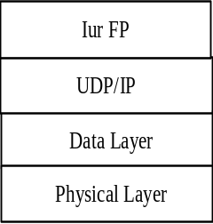
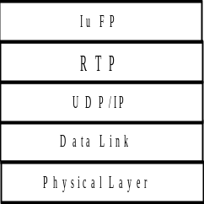
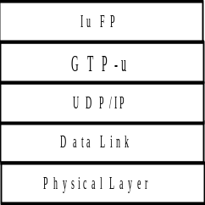
IP UTRAN Protocol Stacks
Signalling transport protocol stack
(IETF Sigtran group)
Iu b user plane protocol stack
Iu r user plane protocol stack
Iu CS user plane protocol stack
Iu PS user plane protocol stack

Slide 36



RAN transition techniques
Rel 99 / 4 Scenario without IP
E1 TDM
BTS
TDM
E1 TDM
MUX
BSC & PCU
BTS
VC
Node B
E1 ATM
E1 ATM
STM-1 ATM
Node B
VC
ATM Switch
RNC

Slide 37

Rel 99 / 4 RAN Transition: Metro Area
E1 TDM
BTS
TDM
E1 TDM
MUX
BSC & PDU
Uses:
TDM over IP/MPLS (GSM)
ATM over MPLS (3G)
BTS
VC
E1 ATM
E1 TDM
Node B
FE
Short term the ATM Switch will be used but longer term it will be atm out of the router
E1 ATM
E1 ATM
FE
FE
Either/Or
STM-1 ATM
VC
Node B
FE
ATM Switch
RNC
Also can aggregate any cell site OAM IP traffic (eg- monitoring applications etc)
STM-1 ATM

Slide 38
Rel 99 / 4 RAN Transition: Non Metro Area
E1 TDM
BTS
TDM
E1 TDM
MUX
BSC & PDU
BTS
VC
E1 ATM
E1 TDM
Node B
Short term the ATM Switch will be used but medium-longer term it will be atm out of the router
N*E1
MLPPP
STM-1 ATM
E1 ATM
N*E1
MLPPP
STM-1 ATM
VC
Node B
ATM Switch
RNC

Slide 39
RAN with Native IP (R5): Urban Area
E1 TDM
E1 TDM
BTS
TDM
E1 TDM
MUX
BSC & PDU
BTS
VC (ATM)
VC
STM-1
E1 ATM
L2/L3
VPN
RNC
Node B
FE
VC
FE
10/100
L2/L3
VPN
FE
L2/L3
VPN
Node B

Slide 40
IP Multimedia Subsystem (IMS)
And
Push To Talk over Cellular (PoC)

Slide 41
IMS with 3GPP Release 5
IMS will allow premium multimedia services
  Video, Audio / VoIP, application sharing etc
IP Multimedia Sub-system
  End-end; IP client directly in end user device
  SIP (Session Initiation Protocol) chosen as signaling / control protocol
    Flexible syntax
    Widely implemented, better interworking between networks (harmonisation)
    Good support for proxy / control functions
  Uses the PS network as the bearer (signaling and data treated as PS data) – rides on PS handover mechanisms to support roaming
  Mandates the use of IPv6 for session control (need transition techniques)
In the future basic CS services can be offered via VoIP on PS and IMS

Slide 42
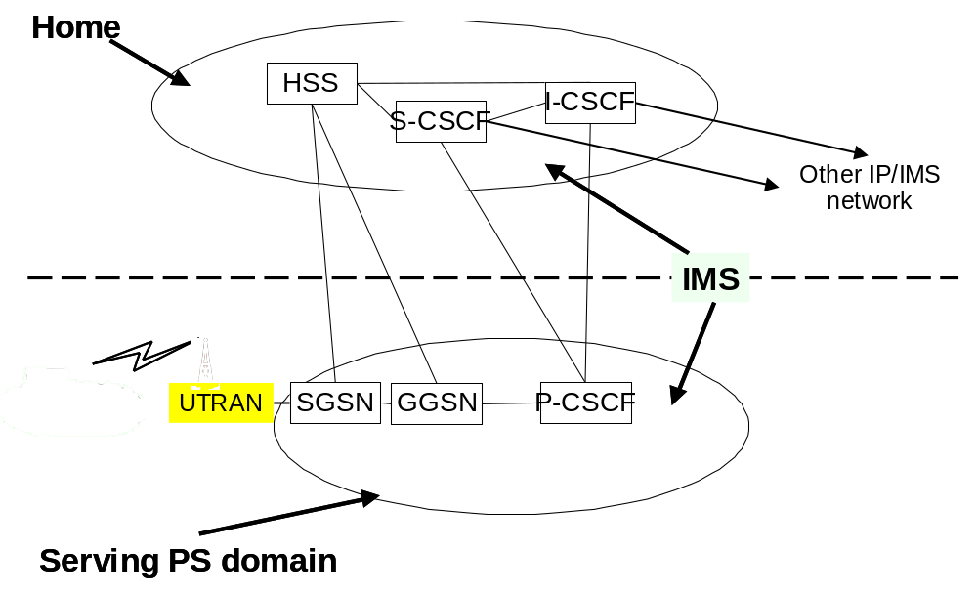
IMS Components
Proxy-Call State Control Function
(P-CSCF): this is the “first contact point” of IMS. It is located in the same network as the GGSN. Its main task is to select the I-CSCF of the Home Network of the user. It also performs some local analysis (e.g. number translation, QoS policing,..).
Interrogating-CSCF (I-CSCF): this is the “main entrance” of the home network: it selects the appropriate S-CSCF.
Serving-CSCF (S-CSCF): it performs the actual Session Control: it handles the SIP requests, performs the appropriate actions (e.g. requests the home and visited networks to establish the bearers), and forwards the requests to the S-CSCF /external IP network of other end user as applicable.

Slide 43


IP Multi-media subsystem
P-CSCF
DNS
DNS
PDF
I-CSCF
S-CSCF
SIP-ALG
SIP
Server
Filter
rules
GGSN
NA(P)T-PT
FW
Terminal
IPv4
IPv6
WLAN Access
Network
PDG
Signaling
Media
Timescale:
  Phase 1 complete for 3GPP Release 5
  3GPP Release 6
  Early realization by some vendors of IMS commonality at the GGSN

Slide 44
Recommended default codecs for conversational multimedia (ref 26.235)
Audio
3G PS multimedia terminals offering audio communication shall support AMR narrowband speech codec. This is the mandatory speech codec.
The AMR wideband speech codec shall be supported when the 3G PS multimedia terminal supports wideband speech working at 16 kHz sampling frequency.
Video
3G PS multimedia terminals offering video communication shall support ITU-T recommendation H.263 baseline. This is the mandatory video codec.
H.263 version 2 Interactive and Streaming Wireless Profile (Profile 3) Level 10 should be supported. This is an optional video codec.
ISO/IEC 14496-2 (MPEG-4 Visual) Simple Profile at Level 0 should be supported. This is an optional video codec.

Slide 45
Push to Talk…what is it?
Push To Talk over Cellular (PTT/PoC)
“Walkie talkie” service
Instant half-duplex communication, one to one or one to many
Successfully deployed for many years in US – eg Nextel using iDEN
New proposal for GSM/3G operators– use IMS – PS solution with following changes:
  Enable operation on non Release 5 networks as well – specifically GPRS (PDP contexts can be always up to cut down setup times)
  Can use IPv4 only (for timing and simplicity)
  Trials and early deployments now
  Interim standards in place, phones becoming available
  (eg Nokia 5140 with dedicated PTT key)
If it takes off, will increase traffic and QoS requirements on GGSN, SGSN and IP infrastructure, even before 3G is widely used

Slide 46
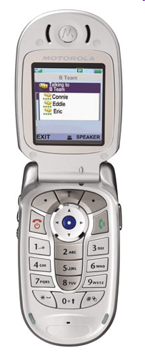
Example phone –
Motorola V400p
Dedicated PTT key
Speaker phone for keyless answer
Group contact list with presence capability
Etc..

Slide 47
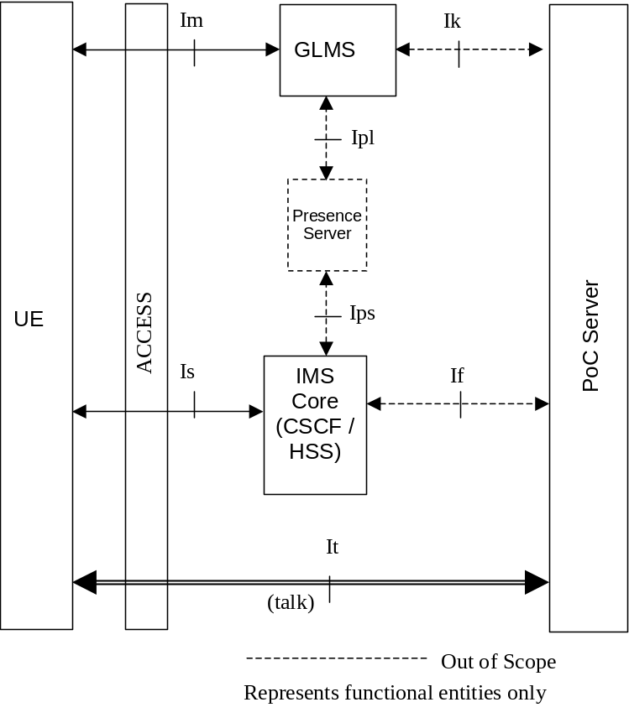
PoC components
Group and List Management Server
Push To Talk over Cellular Server:
  End-point for SIP signaling;
  End-point for RTP and RTCP signaling
  Provides SIP session handling
  Provides policy control for access to groups
  Provides group session handling.
  Provides access control
  Provides do not disturb functionality.
  Provides the floor control functionality;
  Provides the Talker identification
  Provides the Participants information
  Provides the Quality feedback
  Provides the Charging reports
  Provides the Media distribution.
joe.doe@
operator.net

Slide 48
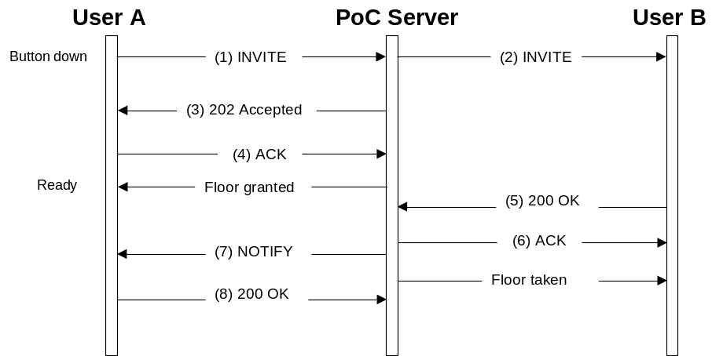
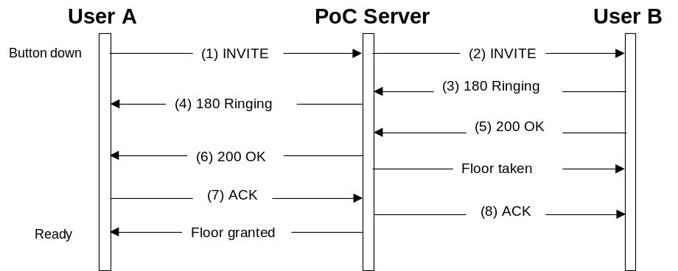
PoC setup flows
Early media and auto answer procedure
Late Media and Manual answer procedure

